Slide 1
FHIR for Developers
Updated for FHIR DSTU!
Ewout Kramer

Slide 2
Introduction
Notes:
Time start-10:00 (10 minutes)

Slide 3

Who am I?
Name: Ewout Kramer
Company: Furore, Amsterdam
Background:
FHIR core team, RIMBAA
Software developer & healthcare architect
Contact:
e.kramer@furore.com
www.thefhirplace.com

Slide 4
Introduce ourselves
About your organization…
HL7 (v2/v3) background?
How did you hear about FHIR?
Platform of choice (.NET, Java, Ruby, …)?
Familiar with HTTP, Xml, JSON, REST?
Persistence technologies used?

Slide 5
Contents of this tutorial
Deconstructing FHIR
FHIR RESTful service interface
Beyond REST
Searching
FHIR on the Wire
Distribution for developers
Building a FHIR server

Slide 6
What perspective?
v3
App
v2
FHIR
PHR
FHIR
Broker
Comm.
Interface
FHIR
DB
Notes:
You’re a message broker routing and translating between v2, v3 and FHIR
Your app interfaces with a PHR using FHIR natively
Your application can communicate using FHIR, but your software uses a proprietary RDBMS
Use FHIR as the common language for a Vendor Neutral Archive
…Or a combination….
You might see data as a nested structure of XML, a series of tables with keys, class-diagrams….

Slide 7
Deconstructing FHIR
Looking at FHIR data modeling concepts from a software engineering perspective
Notes:
Time: 10:00-40:00 (30 minutes)

Slide 8


Resources (review!)
“Resources” are:
Small logically discrete units of exchange
Defined behaviour and meaning
Known identity / location
Smallest unit of transaction
“of interest” to healthcare
V2: Sort of like Segments
V3: Sort of like CMETs

Slide 9

Structure of a Resource
Metadata
Resource
Narrative
Elements
Extensions
Extensions

Slide 10
Composition versus reference
FHIR makes composition and references explicit:
References are in between Resources. No context conduction across references – safe retrieval as individual resources.
Composition is within a Resource: Components have no meaning outside resource, no identity, no separate access path except through resource
Notes:
No context conduction: if a Condition resource references a particular Patient as it's subject, and it links to a Procedure resource as it's cause, there is no automatic rule or implication that the procedure has the same patient as it's subject.

Slide 11
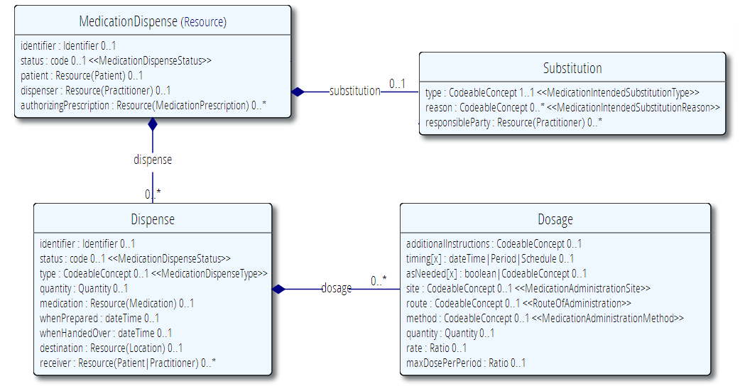
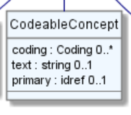
Composition of a Resource
Resource Root
Resource Component
Simple & Complex elements (may be repeating)
Notes:
Medication Dispense – the Resource root
Dispense & Substitution are components within Medication Dispense
Use of non-primitive “datatypes” / “value types”

Slide 12
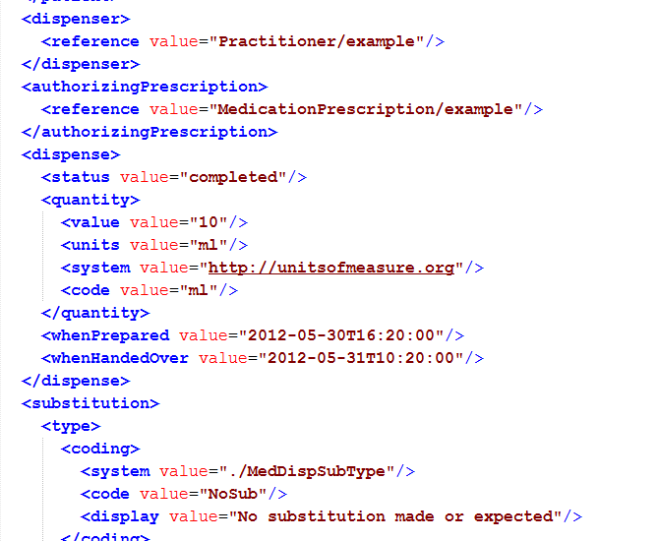
Composition

Slide 13
It’s all about combining resources . . .
http://lab.hospitalA.org/Observation/3ff27
http://pat.registry.org/Patient/223
Observation
Patient
Diagnostic
Report
http://lab.hospitalA.org/DiagRep/4445
Organization
http://hospitalA.org/Organization/1
Practitioner
http://hospitalA.org/Practitioner/87

Slide 14
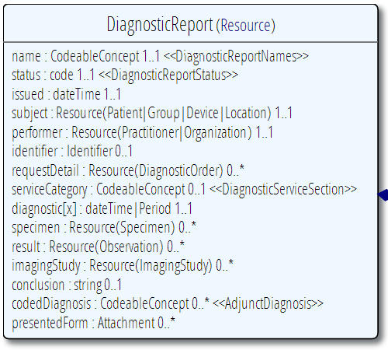
Diagnostic
Report
Patient
Practitioner
Observation
Notes:
References between resources are not by “business key”, it is *not* the patient id, it’s a REST URI!

Slide 15
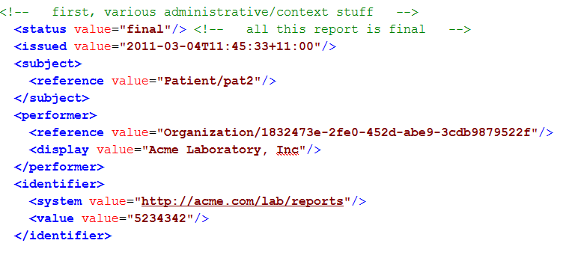
Resource Reference
Example: part of DiagnosticReport

Slide 16

Resource Aggregate
“How do we know where an object
made up of other objects begins
and ends?”
“In any system with persistent storage
of data, there must be a scope for a
transaction that changes data and a way of maintaining the consistency of the data”
Notes:
Very important concept, comparable with the “Aggregate” notion of Domain Driven Design, for which many useful implementation strategies have been documented on the internet.

Slide 17
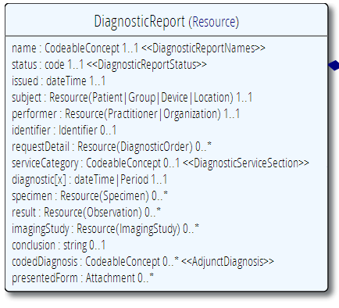
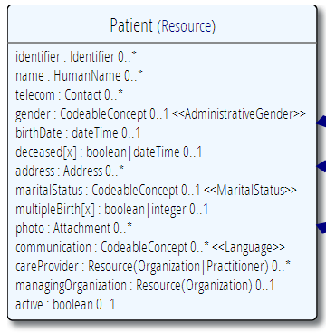
“Business” identifiers
Notes:
Resource Id’s (=URLs) are infrastructural id’s, they differ from “business” identifier.
Many Resources also have business identifiers, they are explicitly modeled, like Patient.identifier (even more than one identifier possible!)
Business identifiers are completely separate from technical resource id’s

Slide 18
A Resource’s identity
In fact: an URL
http://server.org/fhir/Patient/1
resource type
endpoint
identifier
Note: This URL resolves to the current version of a resource
Notes:
This is not only the URL you use to retrieve the resource, it’s also its id.
All URL’s in FHIR are case-sensitive (and so is the id)
It is *metadata*, you won’t find this in the Resource’s definition

Slide 19
Resource metadata
Metadata
Patient
MRN 22234
“Ewout Kramer”
30-11-1972
Amsterdam
Resource Identities
http://fhir.hl7.org/Patient/23E455A3B
http://fhir.hl7.org/Patient/23E455A3B/_history/4
Last updated
2013-12-23T23:33:01+01:00
http://hl7.org/fhir/tag http://example.org/fhir/Status#Test
http://hl7.org/fhir/tag/profile http://hl7.org/fhir/Profile/us-core

Slide 20
The FHIR Elements
Composite
Datatypes (HumanName, Quantity, Period, Address, Identifier )
Constrained Types (Quantity: Distance, Count, Duration, Money)
Metadata
Resource
Narrative
use
Elements
use
Extensions
Extensions
Primitives (integer, boolean,
string, instant)
use
Derived Primitives
(oid, uuid, code, id)
Notes:
Only the Resources are user-definable, other types are “built-in”
Derived primitives are patterns -> validation consists of regexp matching
Constrained types are defined using invariants (OCL, Xpath, prose) -> validation using schematron, code
Narrative and Extension are both ONLY used in Resources
Resources can use both (derived) primitives and composite datatypes in its definitions
Infrastructural types need special handling, not general-purpose types

Slide 21
Start at the bottom: Primitives
boolean | xs:boolean | Values can be either true or false
integer | xs:int | A signed 32-bit integer
decimal | xs:decimal | A rational number. A true decimal, with inbuilt precision (e.g. Java BigDecimal)
base64Binary | xs:base64Binary | A stream of bytes, base64 encoded
instant | xs:dateTime | An instant in time - known at least to the second and always includes a timezone.
string | xs:string | A sequence of Unicode characters.
uri | xs:anyURI | A Uniform Resource Identifier Reference.
date | union of xs:date, xs:gYearMonth, xs:gYear | A date, or partial date as used in human communication. No time zone.
dateTime | union of xs:dateTime, xs:date, xs:gYearMonth, xs:gYear | A date, date-time or partial date as used in human communication. If hours and minutes are specified, a time zone must be populated.
Notes:
The lexical rendering for these primitives in Xml is the same as in JSON (maybe this should go in the serialization section)
Expressing the allowed values in terms of XSD primitives brings in more variability then we would like. E.g. “0” and “1” are valid for xs:boolean. “+000004”, “4”, “+4” are all valid decimals.

Slide 22
Derived primitives
Using the ISO date/time with timezone
“1951”, “1951-06” and “1951-06-04”
“1951-06-04T10:57:34.0321+01”
“1951-06-04T10:57:34.0321Z”
Notes:
TODO: Search on timestamps (lower, upper bound), converting to zulu, user-timezone, sorting of times etc.
* Old-school types built on classis logic and math from the Greek, we have new stuff too…types based on urls!

Slide 23
Derived primitives
Based on uri(!): OID and UUID
urn:oid:1.2.3.4.5
urn:uuid:a5afddf4-e880-459b-876e-e4591b0acc11
Based on string:
code (string of characters, may contain single spaces) - “4548-4”, “active”, “not known”
id ([a-z0-9\-\.]{1,36})
Notes:
TODO: Search on timestamps (lower, upper bound), converting to zulu, user-timezone, sorting of times etc.
* Old-school types built on classis logic and math from the Greek, we have new stuff too…types based on urls!

Slide 24
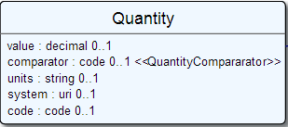
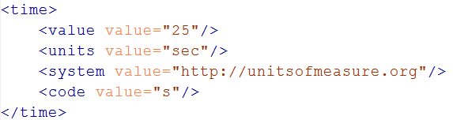
Level up: Composite Datatypes
Notes:
The content of a primitive is not rendered in XML as a text node but as an attribute
Notice how the “system” of a code is now a uri, so unlike in v3 an OID is now ALSO a uri (urn:oid:1.2.3.4.5)

Slide 25
Datatypes
Let’s take a look at the “Data Types” section of the FHIR specification at
http://www.hl7.org/implement/standards/fhir/datatypes.html
Notes:
Datatypes use both primitives and other datatypes.
Some datatypes use attributes with cardinality > 1
CodeableConcept.primary is actually refers to a coding in CodeableConcept.coding, so is not a code itself.
Quantity has constrained variations Distance, Count, Duration, Money. They introduce constraints on useable units, but do not add attributes, so not shown here.
Note that HumanId.assigner refers to a Resource

Slide 26
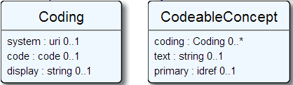
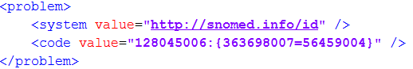
Coded types
Codes are defined in code systems
Notes:
Examples is from http://www.hl7.org/implement/standards/fhir/observation.htm
Bindings can be Incomplete (HL7 defines some codes for it, but you can add your own), Fixed (HL7 defines the only codes that are allowed) and Example (no specific codes defined, but some are given to give you an idea of what goes in the element)

Slide 27
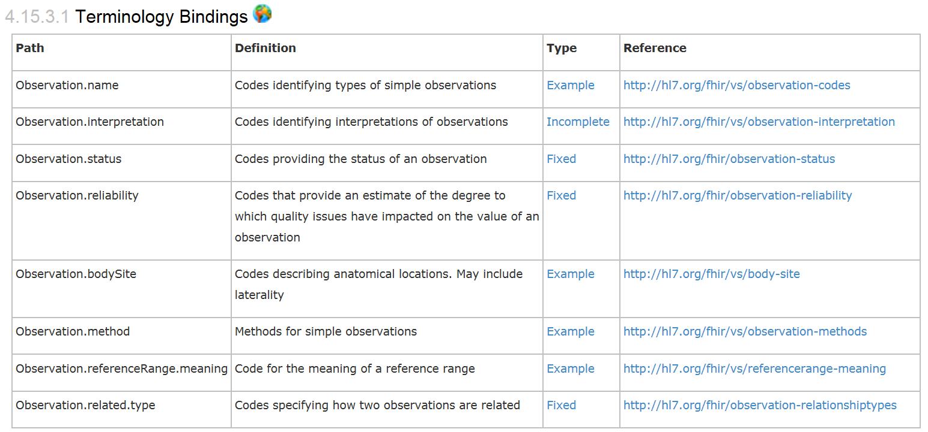
Coded types
When used in a Resource, the modelers include Bindings
Bindings specify which codes can be used
Notes:
Examples is from http://www.hl7.org/implement/standards/fhir/observation.htm
Bindings can be Incomplete (HL7 defines some codes for it, but you can add your own), Fixed (HL7 defines the only codes that are allowed) and Example (no specific codes defined, but some are given to give you an idea of what goes in the element)

Slide 28
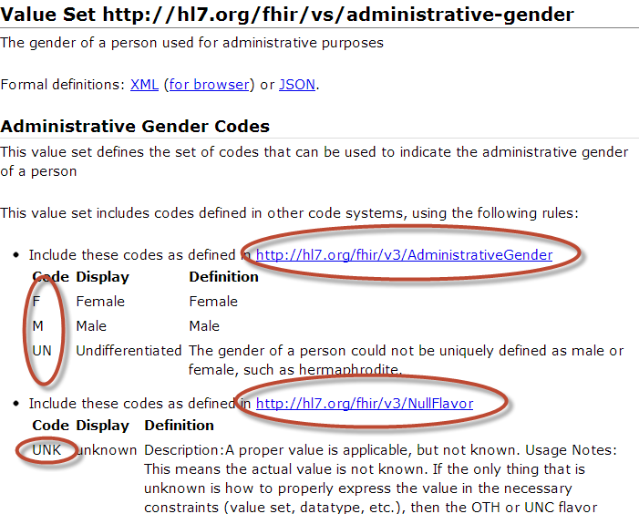
Notes:
Bindings use ValueSets to define what codes are allowed.
Patient.administrativeGender has a binding using the valueset “http://hl7.org/fhir/vs/administrative-gender”
This valueset includes codes from two code systems http://hl7.org/fhir/v3/AdministrativeGender and http://hl7.org/fhir/v3/NullFlavor
So yes, FHIR reused code systems from v3 (and v2), and has some defined specifically for FHIR.

Slide 29
Goto Some interesting valuesets to look at them

Slide 30
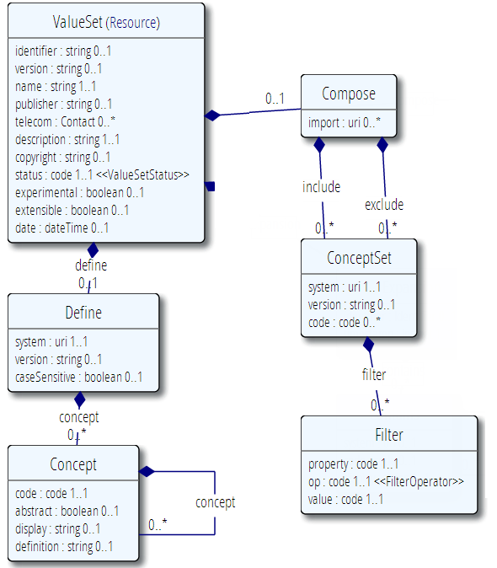
Publication meta-data
Concepts from 1 or more existing systems
Additional concepts

Slide 31
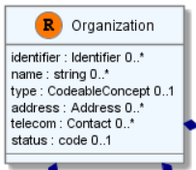
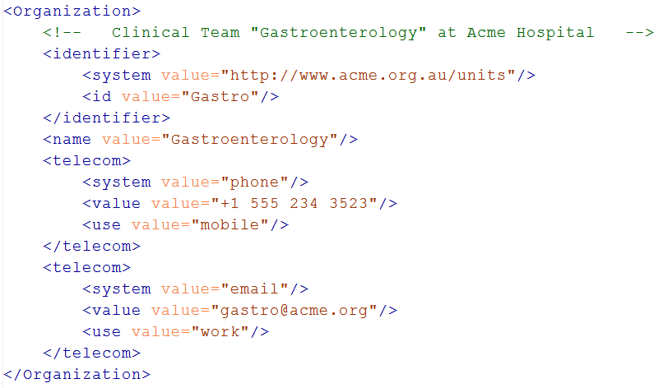
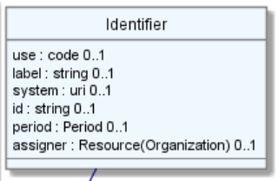
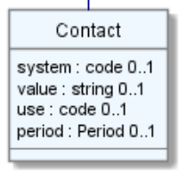
Level up: resources
Notes:
The element “identifier” is of type Identifier
The element “telecom” repeats, there is no notion of a “list” in Xml.
Empty elements are left out

Slide 32
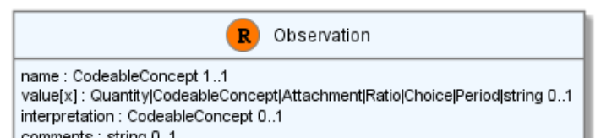
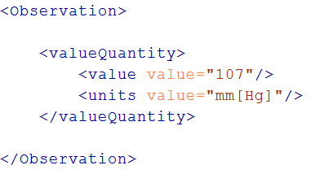
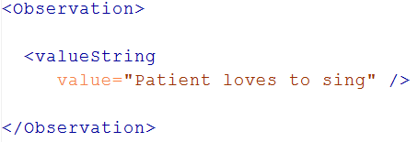
“Choice” properties
Notes:
* value[x] means: An element with a name that starts with “value”. The [x] is replaced by the (capitalized) name of the actual datatype

Slide 33
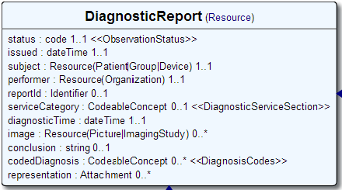
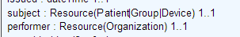
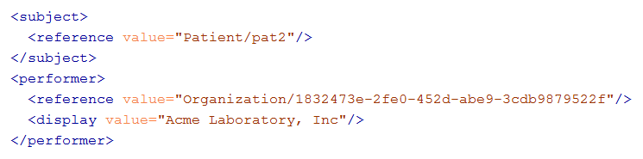
References
Notes:
There are references that can reference more than one type of resource! In this example: Resource(Patient | Group | Device)
The reference has a “type” element to indicate the kind of Resource that is referenced
References may be: Relative (on the same server), absolute URL (somewhere external) and internal (not treated here)

Slide 34
Quick look at extensions
Metadata
Resource
Narrative
Elements
Extensions
Extensions
Notes:
Only the Resources are user-definable, other types are “built-in”
Derived primitives are patterns -> validation consists of regexp matching
Constrained types are defined using invariants (OCL, Xpath, prose) -> validation using schematron, code
Narrative and Extension are both ONLY used in Resources
Resources can use both (derived) primitives and composite datatypes in its definitions
Infrastructural types need special handling, not general-purpose types

Slide 35
Extensions
Patient
MRN 22234
“Ewout Kramer”
30-11-1972
Amsterdam
+ Haircolor BROWN
You can extend:
Resources
Elements of Resources
FHIR Datatypes
Organization “ACME Hospital”
National Drive 322
Orlando, FL
+ Taxoffice Id NLOB33233

Slide 36
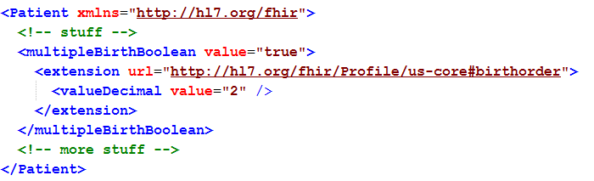
Extending a multiple birth
Key = location of formal definition
Value = value according to definition
Notes:
Really any FHIR element (Resource, Datatype, Primitive) can be extended. Just nest an <extension> element under the thing you want to extend
You should be able to go to the formal definition endpoint and get the definition of the extension.
Note: birth order is already provided for in FHIR through the multipleBirthInteger

Slide 37
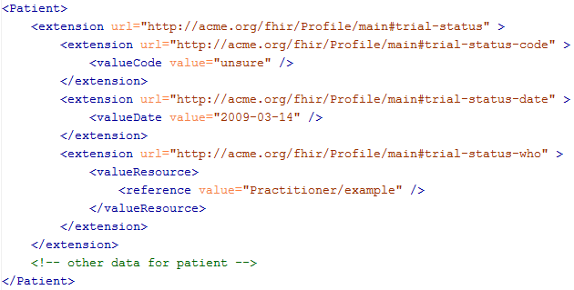
Complex extensions

Slide 38
Quick look at narrative
Metadata
Resource
Narrative
Elements
Extensions
Extensions
Notes:
Only the Resources are user-definable, other types are “built-in”
Derived primitives are patterns -> validation consists of regexp matching
Constrained types are defined using invariants (OCL, Xpath, prose) -> validation using schematron, code
Narrative and Extension are both ONLY used in Resources
Resources can use both (derived) primitives and composite datatypes in its definitions
Infrastructural types need special handling, not general-purpose types

Slide 39
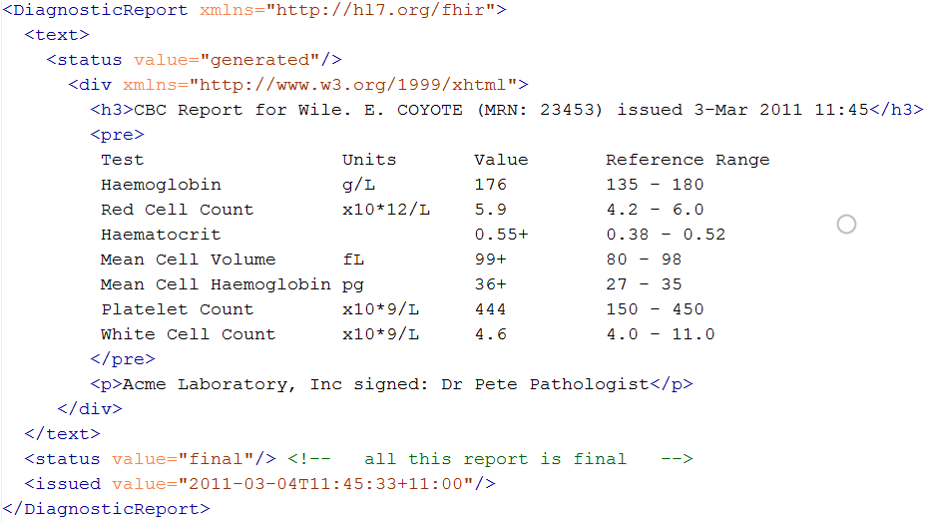
Narrative
Notes:
Resources SHOULD always contain narrative to support human-consumption as a fallback. However, in a strictly managed trading systems where all systems share a common data model and additional text is unnecessary or even a clinical safety risk, the narrative may be omitted.

Slide 40
REST service interface
How FHIR uses RESTful principles to communicate Resources
Notes:
Time: 0:50:00-1:30:00 (40 minutes)

Slide 41
Paradigms
FHIR supports 4 interoperability paradigms
REST
Documents
Messages
Services
REST
Notes:
* Content is the same

Slide 42
REST?
“REpresentational State Transfer”
Represent your data as “resources”
Make “Resources” URI addressable
Use HTTP to do CRUD operations
Resources may be exchanged using different representations

Slide 43
Possibly distributed…
FHIR server @ pat.registry.org
FHIR server @ lab.hospitalA.org
Patient/223
DiagnosticReport/4445
Observation/3ff27
Patient
subject
Observation
Diagnostic
Report
result
managing
performer
FHIR server @ hospitalA.org
Organization/1
Practitioner/87
Organization
Practitioner

Slide 44
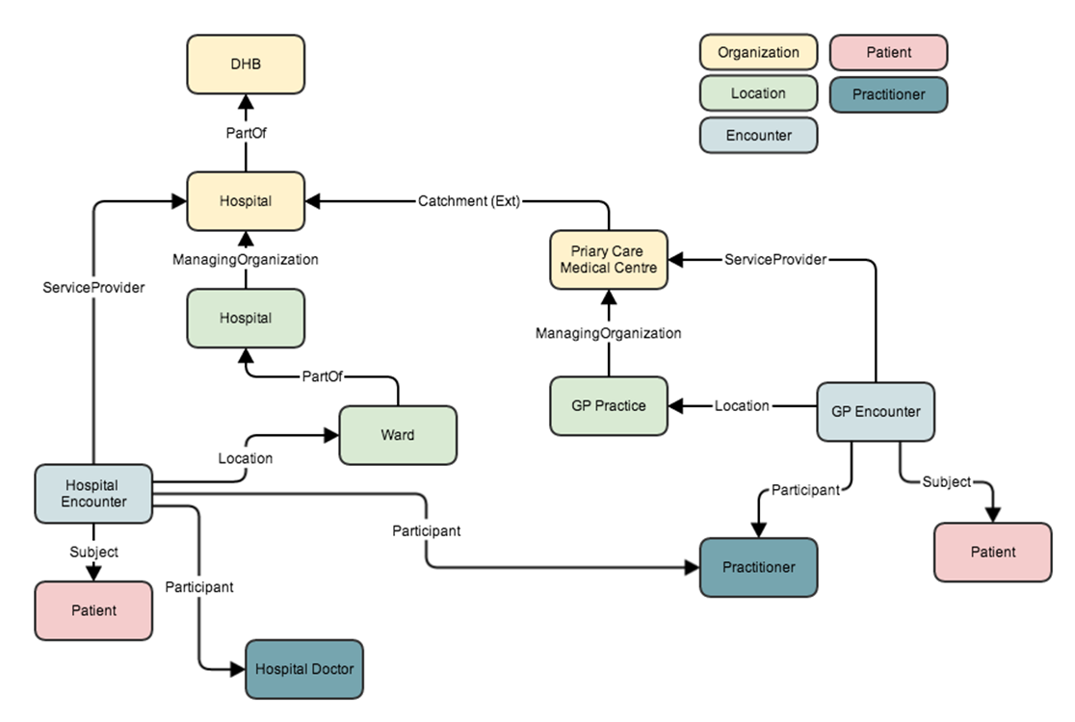
http://fhirblog.com/2014/01/24/modelling-encounters-with-fhir/

Slide 45
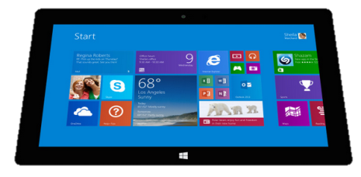

“Repository” model of healthcare
Hospital System
Lab System
Create
Update
Create
Update
Create
Update
Query
Query
Subscribe
FHIR server
Patient
Diagnostic
Report
Observation
Patient
Observation
Organization
Patient
Observation

Slide 46
Just a quick GET
GET /fhir/Patient/1 HTTP/1.1
HTTP/1.1 200 OK
Content-Type: application/xml+fhir;charset=utf-8
Content-Length: 787
Content-Location:
http://fhir.furore.com/fhir/Patient/1/_history/1
Last-Modified: Tue, 29 May 2012 23:45:32 GMT
HTTP Verb + path
UTF-8 encoded
<?xml version="1.0" encoding="UTF-8"?>
<Patient xmlns="http://hl7.org/fhir"><identifier><label>SSN</label><identifier><system>
http://hl7.org/fhir/sid/usssn</system><id>444222222</id></identifier></identifier><name><use>official</use><family>Everywoman</family><given>Eve</given></name><telecom><system>phone</system><value>555-555 2003</value><use>work</use></telecom><gender><system>http://hl7.org/fhir/sid/v2-0001</system>
<code>F</code></gender><birthDate>1973-05-31</birthDate><address><use>home</use><line>2222 Home Street</line></address><text><status>generated</status><div xmlns="http://www.w3.org/1999/xhtml">Everywoman, Eve. SSN:444222222</div></text></Patient>
See the BOM?
Notes:
You can retrieve any person using a GET on the person’s id, which is just an url on the server: /fhir/Patient/<id>
We have our own MIME-type: “text/xml+fhir”
Note that FHIR always uses UTF-8. Since this is not the default for HTTP, the server explicitly mentions this
But should mean the xml encoding mentions “utf-8” and that the payload is really encoded in utf-8
There can be a Byte Order Mark, but hopefully your framework handles all that ;-)
The response returns a Content-Location header with a version-specific location….see next slide

Slide 47
A Resource’s REST identity
In fact: an URL
http://server.org/fhir/Patient/1
resource type
endpoint
identifier
Note: This URL resolves to the current version of a resource
Notes:
This is not only the URL you use to retrieve the resource, it’s also its id.
All URL’s in FHIR are case-sensitive (and so is the id)

Slide 48
Remember metadata?
Metadata
Patient
MRN 22234
“Ewout Kramer”
30-11-1972
Amsterdam
Resource Identities
http://fhir.hl7.org/Patient/23E455A3B
http://fhir.hl7.org/Patient/23E455A3B/_history/4
Last updated
2013-12-23T23:33:01+01:00
http://hl7.org/fhir/tag http://example.org/fhir/Status#Test
http://hl7.org/fhir/tag/profile http://hl7.org/fhir/Profile/us-core

Slide 49
Tag metadata
GET /fhir/Patient/1 HTTP/1.1
HTTP/1.1 200 OK
Content-Location: http://sever.om/fhir/Patient/1/_history/12
Last-Modified: Tue, 29 May 2012 23:45:32 GMT
Category: http://example.org/fhir/Status#Test; scheme=" http://hl7.org/fhir/tag"; label="Our test tag"
http://hl7.org/fhir/tag | A general tag
http://hl7.org/fhir/tag/profile | A profile tag - a claim that the Resource conforms to the profile identified in the term
http://hl7.org/fhir/tag/security | A security label
Notes:
Just a quick look at tags, so the term had been mentioned

Slide 50
Mapping (meta)data to HTTP
Resource data
Resource id
Resource version
Last update date
Tags
http body
Url
Content-Location header
Last-Modified header
Category header

Slide 51
One more look at the header
GET /fhir/Patient/1 HTTP/1.1
HTTP/1.1 200 OK
Content-Type: application/xml+fhir;charset=utf-8
Content-Length: 787
Content-Location: http://fhir.furore.com/fhir/Patient/1/_history/12
Last-Modified: Tue, 29 May 2012 23:45:32 GMT
Notes:
You can retrieve any person using a GET on the person’s id, which is just an url on the server: /fhir/person/@<id>
We have our own MIME-type: “text/xml+fhir”
Note that FHIR always uses UTF-8. Since this is not the default for HTTP, the server explicitly mentions this
But should mean the xml encoding mentions “utf-8” and that the payload is really encoded in utf-8
There can be a Byte Order Mark, but hopefully your framework handles all that ;-)
The response returns a Content-Location header with a version-specific location….see next slide

Slide 52
For a specific version…
We have the version-specific URL
http://server.org/fhir/ (continued)
Patient/1/_history/4
base path
resource type
identifier
version id
Notes:
Both the Resource id URL and the version-specific URL are used on many places of the REST spec and resource content (References!). They are always used consistently in this form.

Slide 53
Support for versions
33, v12 – 2012-12-04
/server.org/fhir/Patient/33/_history/12
33, v13 – 2012-12-05
/server.org/fhir/Patient/33/_history/13
33, v14 – 2012-12-08
/server.org/fhir/Patient/33/_history/14
33, v15 – 2012-12-09
/server.org/fhir/Patient/33/_history/15
/server.org/fhir/Patient/33
Notes:
* Note that you have two ways (at one moment) to reach version 15

Slide 54
REST “representations”
GET /fhir/Patient/1?_format=json HTTP/1.1
HTTP/1.1 200 OK
Content-Type: application/json+fhir;charset=utf-8
Content-Length: 787
GET /fhir/Patient/1 HTTP/1.1
Accept: application/json+fhir
HTTP/1.1 200 OK
Content-Type: application/json+fhir;charset=utf-8
Content-Length: 787
Notes:
You can retrieve any patient using a GET on the patient’s id, which is just an url on the server: /fhir/Patient/<id>
We have our own MIME-type: “application/xml+fhir” and “application/json+fhir”

Slide 55
Question
DO I REALLY HAVE TO IMPLEMENT VERSIONS?
DO I REALLY NEED TO SUPPORT THAT PRE-HISTORIC XML STUFF?
NO, You are not required to keep history, and may return 410 (Gone) on a “vread” for any request for an older version than the current one!

Slide 56
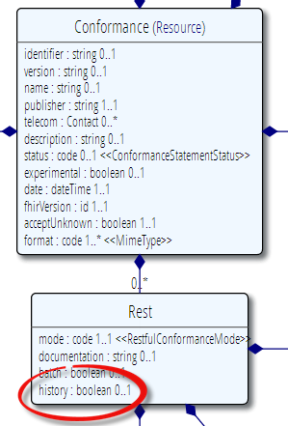
Conformance
Which FHIR version?
Which Resources?
What search operations?
What formats?
Is this a test server?
Who can I contact?
What’s the name of the software?
DO YOU SUPPORT HISTORY?
DO YOU SUPPORT XML/JSON?
http://www.hl7.org/fhir/conformance.htm

Slide 57
REST in the spec
Let’s look at these operations in the specification….

Slide 58
Mapping to verbs
create 2.1.10
The create interaction creates a new resource in a server assigned location. The create interaction is performed by an HTTP POST operation as shown:
POST [service-url]/[resourcetype] (?_format=mimeType)
read 2.1.6
The read interaction accesses the current contents of a resource. The interaction is performed by an HTTP GET operation as shown:
GET [service-url]/[resourcetype]/{id} (?_format=mimeType)
update 2.1.8
The update interaction creates a new current version for an existing resource or creates a new resource if no resource already exists for the given id. The update interaction is performed by an HTTP PUT operation as shown:
PUT [service-url]/[resourcetype]/{id} (?_format=mimeType)
delete 2.1.9
The delete interaction removes an existing resource. The interaction is performed by an HTTP DELETE operation as shown:
DELETE [service-url]/[resourcetype]/{id}

Slide 59
To create a resource
You POST the contents to an url which indicates the resource type:
E.g. http://server.org/fhir/Patient
Supply body’s format in Content-Type header
Server returns 201 (Created).
Returns only the newly assigned version id URL in the Location header.

Slide 60
To update a resource
Use PUT on the resource’s URL, with the new contents in the body
Tell server the body’s format (xml/json) in the Content-Type header
Server returns 200 and the URL to new version in the Content-Location header.

Slide 61
Using PUT to create
Server might/might not allow you to PUT to an id that does not yet exist.
If it does: Server returns 201 and resource gets created at that location ➔ client determines resource’s id!
If it does not: server returns 405 (Method not allowed)
Notes:
- Whether server allows this depends on the level of trust between server and client: e.g. in-house scenario versus nation-wide network.

Slide 62
Version-aware updates
Server requires client to send Content-Location header with a version-specific URL
Server uses this to check whether you are updating the latest version.
Server will then return 409 (Conflict) if it has been updated by someone else in the meantime
Notes:
Behaviour depends on server configuration (and made public in a conformance statement).

Slide 63
What’s a ‘deleted’ Resource?
Trying read operations will return in a 410 (Gone) result in stead of 404 (Not Found)
The resource will not be returned by the search operation.
You can “undelete” by doing an update with fresh content
Just a “marker” in a resource’s history
Notes:
* the deletion operation should be understood as deleting the record of the resource, with nothing about the state of the real-world corresponding resource implied.

Slide 64
Version history - deletions
33, v12 – 2012-12-04
/server.org/fhir/Patient/33/_history/12
33, v13 – 2012-12-05
/server.org/fhir/Patient/33/_history/13
33, v14 – 2012-12-08
/server.org/fhir/Patient/33/_history/14
33, v15 – 2012-12-09
/server.org/fhir/Patient/33/_history/15
33, v16 – 2012-12-10
DELETION
/server.org/fhir/Patient/33/_history/16
/server.org/fhir/Patient/33
Notes:
* Now, if you query for /server.org/fhir/patient/@33, you get a 410

Slide 65
Version history - revival
33, v13 – 2012-12-05
/server.org/fhir/Patient/33/_history/13
33, v14 – 2012-12-08
/server.org/fhir/Patient/33/_history/14
33, v15 – 2012-12-09
/server.org/fhir/Patient/33/_history/15
33, v16 – 2012-12-10
/server.org/fhir/Patient/33/_history/16
33, v17 – 2012-12-11
/server.org/fhir/Patient/33/_history/17
/server.org/fhir/Patient/33
Notes:
* The resource returns back to life!

Slide 66
Resources in code
How resources are made into classes in the supplied reference implementations
Notes:
Time: 40:00-50:00 (10 minutes)

Slide 67
Reference implementations
Contents
Model – classes generated from the spec
Parsers – Parsers generated from the spec
Serializers – Serializers generated from the spec
FhirClient
Validation (currently Java only)
Java – Everything on the downloads page
.NET – NuGet “FHIR”, or GitHub “fhir-net-api”

Slide 68
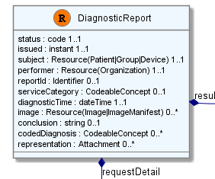
Object Model
[FhirResource("DiagnosticReport")]
public partial class DiagnosticReport : Resource
{
public Code<ObservationStatus> Status {…}
public Instant Issued {…}
public ResourceReference Subject {…}
public ResourceReference Performer {…}
public Identifier ReportId {… }
public
List<DiagnosticReportRequestDetailComponent> RequestDetail { …}

Slide 69
Parsing/Serializing using C#
// Create a file-based reader for Xml
XmlReader xr = XmlReader.Create(
new StreamReader(@"publish\observation-example.xml"));
// Parse the Observation from the stream
var obs = (Observation)FhirParser.ParseResource(xr);
// Modify some fields of the observation
obs.Status = Observation.ObservationStatus.Amended;
obs.Value = new Quantity() { Value = 40, Units = "g" };
// Serialize the in-memory observation to Json
var jsonText = FhirSerializer.SerializeResourceToJson(obs);

Slide 70
Parsing/Serializing using Java
XmlParser xml = new XmlParser();
Observation obs = (Observation)xml.parse(new FileInputStream(“observation.xml"));
obs.setStatusSimple(ObservationStatus.amended);
Quantity newValue = new Quantity();
newValue.setValueSimple(new BigDecimal(40)); newValue.setUnitsSimple("g");
obs.setValue( newValue );
ByteArrayOutputStream bos = new ByteArrayOutputStream();
JsonComposer comp = new JsonComposer();
comp.compose(bos, obs, true);
String json = bos.toString("UTF8");

Slide 71
Using FHIR Client in C#
var client = new FhirClient(
new Uri("http://fhir.com/svc/fhir"));
var patEntry = client.Read<Patient>("1");
var pat = patEntry.Resource;
var restId = patEntry.Id;
var tags = patEntry.Tags;
pat.Name.Add(HumanName.ForFamily("Kramer")
.WithGiven("Ewout"));
client.Update<Patient>(patEntry);

Slide 72
Using FHIR Client in Java
FHIRClient client = new FHIRSimpleClient();
client.initialize("http://spark.furore.com/fhir");
AtomEntry<Patient> pe = client.read(Patient.class, "1");
Patient p = pe.getResource();
HumanName hn = new HumanName();
hn.getFamily().add(Factory.newString_("Kramer"));
hn.getGiven().add(Factory.newString_("Ewout"));
p.getName().add(hn);
client.update(Patient.class, p, "1");

Slide 73
BUNDLES
How FHIR uses Atom to communicate sets of resources
Notes:
Time: 0:50:00-1:30:00 (40 minutes)

Slide 74
Communicating lists
We need to communicate lists of Resources
Search result
History
Documents or messages
Multiple-resource inserts (“batches”)
So, we need an industry-standard to represent lists, and a place to put our metadata

Slide 75

Resource
Bundle
Metadata
Metadata
Bundle
Resource
Resource
Narrative
Elements
Resource
Extensions
Extensions

Slide 76
Bundles
Atom RFC 4287 + Tombstones RFC 6721
Poll-based protocol for keeping up-to-date with newsfeeds (RSS and Atom)
You can “subscribe” to a FHIR feed and get updates
Notes:
- In our previous section on REST we saw how we mapped this metadata to HTTP headers, but in a query result, we need to find a way to map this to a list, Atom

Slide 77
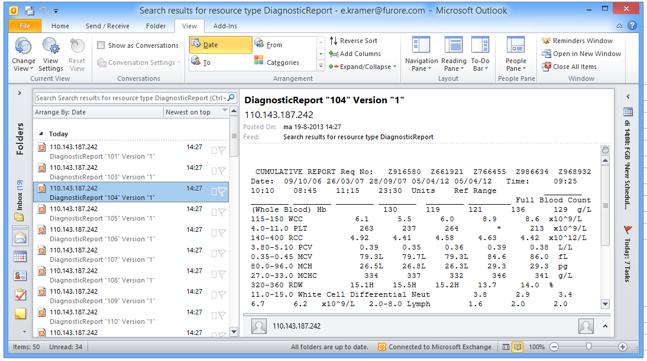
New reports in the mail

Slide 78
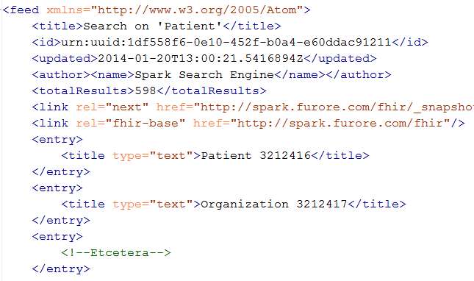
An example Bundle
Notes:
Note that the id of the resource is kept outside the resource itself
Atom has many other meta-data items (not shown), which we will discuss later.

Slide 79
Resource metadata
Metadata
Patient
MRN 22234
“Ewout Kramer”
30-11-1972
Amsterdam
Resource Identity
http://fhir.hl7.org/Patient/23E455A3B
Last updated
2013-12-23T23:33:01+01:00
http://hl7.org/fhir/tag http://example.org/fhir/Status#Test
http://hl7.org/fhir/tag/profile http://hl7.org/fhir/Profile/us-core

Slide 80
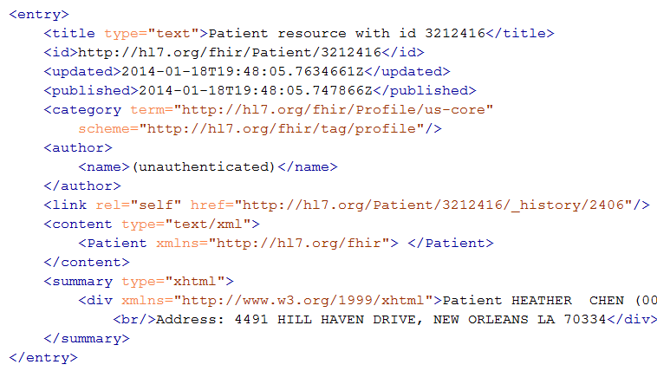
Resource Entry
Resource id
Last modified
Tags
Version-specific id
Resource content
Human-readable form,
just like Resource.text
Notes:
See how the resource meta-data is mapped to equivalent Atom members
Author is required by atom, so you’ll have to keep track who authored the resource, which might well be the user that POSTed it to your RESTful endpoint
Summary is optional, but it is easy to fill it with the Resource’s <text> (human readable narrative), so Feed readers have a way to display the contents of a resource. Yes, this means the summary is present twice in the entry.
All elements you see here are Atom spec, not FHIR

Slide 81
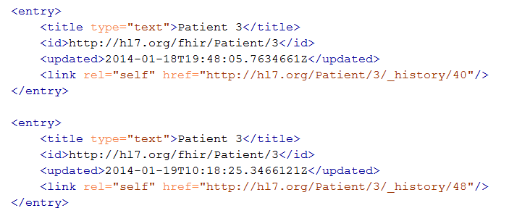
Multiple versions of entries
Same
id!
Notes:
Multiple versions are supported explicitly by Atom by having mutliple entries with the same id, but a different ‘updated’ date
Notice how the ‘self’ links do differ, these are different versions after all.

Slide 82
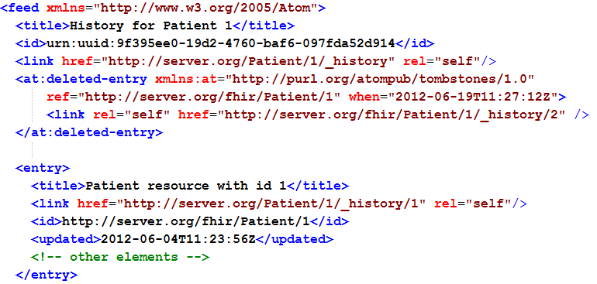
Atom Tombstones - Deletions
Notes:
Brand-new RFC, probably not much support in frameworks (yet).
Note the additional namespace
Updated Timestamp is still present, but is now called “when”.

Slide 83
Atom in JSON
There’s not yet a way to render Atom in JSON, though there are initiatives, all ugly.
So, we had to (sorry) roll our own….
…very straightforward, single-purpose
Atom JSON solution
(Note: MIME type is still application/json!)

Slide 84
Json Atom - Example
{
"title": "Search result",
"updated": "2012-09-20T12:04:45Z",
"id": "urn:uuid:50ea3e5e-b6a7-4f55-956c-caef491bbc08",
"link": [ { "rel": "self", "href": "http://server.org/fhir/Patient?format=json" } ],
"entry": [
{ "title": "Resource of type Patient, with id = 1 and version = 1",
"link": [ { "rel": "self", "href": "http://server.org/fhir/Patient/1/_history/1" } ],
"id": "http://fhir.furore.com/fhir/Patient/1",
"updated": "2012-05-29T23:45:32Z",
"published": "2012-09-20T12:04:47Z",
"author": [ { "name": "Grahame Grieve / HL7 publishing committee" } ],
"content":
{ "Patient": { } }
}
]
}
Notes:
Just take a quick glimpse, it’s a pretty trivial translation of the Xml form to JSON, removing all needs for namespaces and attributes, and turning repeating elements into JSON arrays.

Slide 85
Bundles
For both Java and C#, reference has custom-built Atom parser
For .NET, you could use the framework’s SyndicationFeed
A bit more low-level
No support for deleted-entries (even parse problems)
Incompatible with WinRT (Win8 mobile apps)
Notes:
* You might wonder: Since bundles are Atom, why not use standard Atom parsers?

Slide 86
Bundles in C#
Abstraction on top of Atom parser
Bundle = feed, BundleEntry = entry.
Bundle result = new Bundle() { Title = "Demo bundle" };
result.Entries.Add(new ResourceEntry<Patient>()
{ LastUpdated=DateTimeOffset.Now, Content = new Patient() });
result.Entries.Add(new DeletedEntry()
{ Id = new Uri("http://..."), When = DateTime.Now });
var bundleXml = FhirSerializer.SerializeBundleToXml(result);

Slide 87
Bundles in Java
AtomFeed feed = new AtomFeed();
feed.setTitle("Demo bundle");
AtomEntry pat = new AtomEntry();
pat.setUpdated(Calendar.getInstance());
pat.setResource(new Patient());
feed.getEntryList().add(pat);
AtomEntry del = new AtomEntry();
del.setUpdated(Calendar.getInstance());
del.setDeleted(true); del.setId("http://nu.nl/fhir");
feed.getEntryList().add(del);
ByteArrayOutputStream bos = new ByteArrayOutputStream();
AtomComposer comp = new AtomComposer();
comp.compose(bos, feed, true);
String xml = bos.toString("UTF8");

Slide 88
Example: Keeping in sync
History of all resources on server
http://server.org/fhir/_history
History of all patient resources on server
http://server.org/fhir/Patient/_history
History of specific patient on server
http://server.org/fhir/Patient/1/_history
A history of all changes: updates and deletions, ordered by newest first
Limit with _since and _count

Slide 89
SEARCH FUNCTIONALITY
And finally, the last REST operation (for now):
Notes:
Time: 1:30:00-1:50:00 (20 minutes)

Slide 90
Getting “all” patients
http://server.org/fhir/Patient
Always returns a paged feed
Use _count to indicate number of results per page
Special case of the “real” search operation: http://server.org/fhir/Patient/_search?name=eve http://server.org/fhir/Patient?name=eve

Slide 91
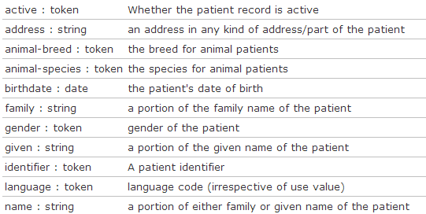
Search (patient)
Each resource has a set of “standard” search operations, so not every element can be searched!:
Our last search used this one

Slide 92
Combining parameters
Specifying multiple parameters finds resources matching all params ➔ “AND”
Parameters may list multiple values ➔ “OR”
http://server.org/fhir /Patient/search?
birthdate=1972-11-30
&language=NL,FR

Slide 93
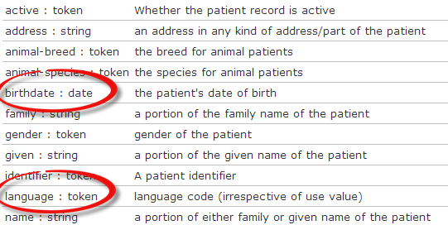
Search (Patient)
Each search parameter has a ‘type’
Parameter
Type

Slide 94
Ok I get it…or not?
http://server.org/fhir/Patient/ 406 hits
http://server.org/fhir/Patient?gender=M 234 hits
http://server.org/fhir/Patient?gender=F 167 hits
Total: 234 + 167 = 401
http://server.org/fhir/Patient/ 406 hits
http://server.org/fhir/Patient?gender=M 234 hits
http://server.org/fhir/Patient?gender=F 167 hits
http://server.org/fhir/Patient?gender:missing=true 5 hits
Total: 234 + 167 + 5 = 406
Notes:
Look at modifiers on the HL7 FHIR site (:exact, :missing, etc.)

Slide 95
Chained searches
Patient has a search for “name”.
Observation has a search for “subject” (the id of the Patient, Group or Device)
How do I find Observations for a patient, searching using his name?

Slide 96
2 queries in 1
You (as a client) don’t need to do separate operations, just one:
http://server.com/fhir/Observation/_search?
subject.name=jim
But note: this still only works on the predefined search parameters. You cannot just use any property of the resource.

Slide 97
More optimalizations
Say we do:
http://fhir.com/fhir/Observation?date=2014-01-20
We get back: a Bundle with 0..* “Observations”
Now, usually, wouldn’t we want the Patient information too? => Need to do “N” queries for the Observation’s “subject”
Quicker:
?_include=Observation.subject
Returns both Observations + Patients

Slide 98
Beyond REST
How FHIR supports messages and documents
Notes:
Time: 1:50:00-2:00:00 (10 minutes)

Slide 99
Paradigms
FHIR supports 4 interoperability paradigms
REST
Documents
Messages
Services

Slide 100
Regardless of paradigm
the content is the same
Receive a lab result in a message…
FHIR
Repository
FHIR Message
FHIR Document
Lab System
REST
National
Exchange
…Package it in a discharge summary document

Slide 101
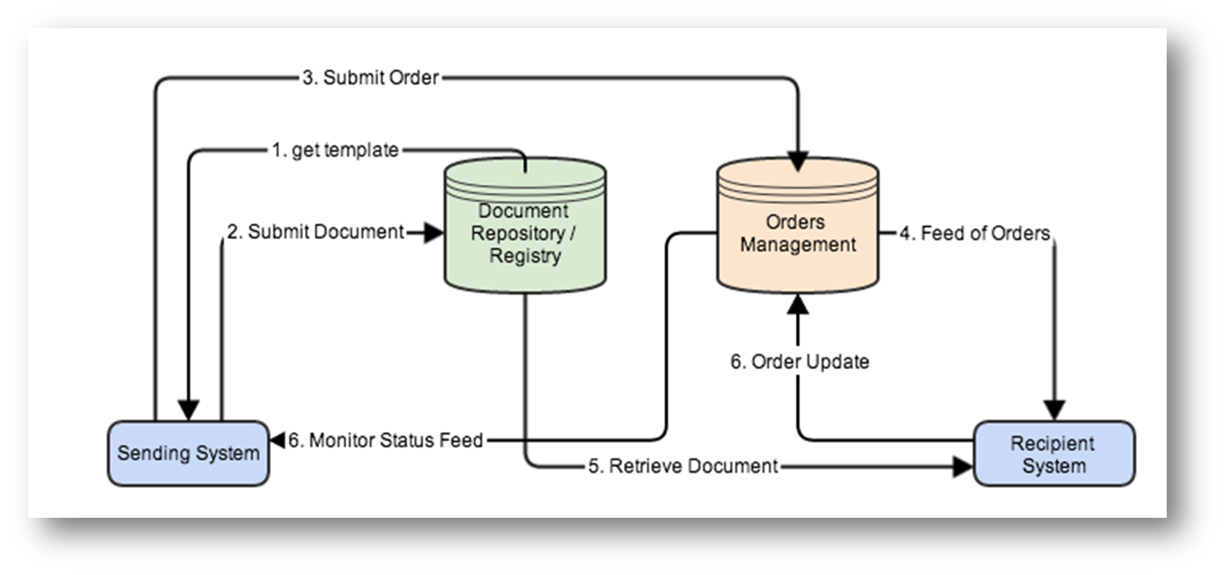

Slide 102
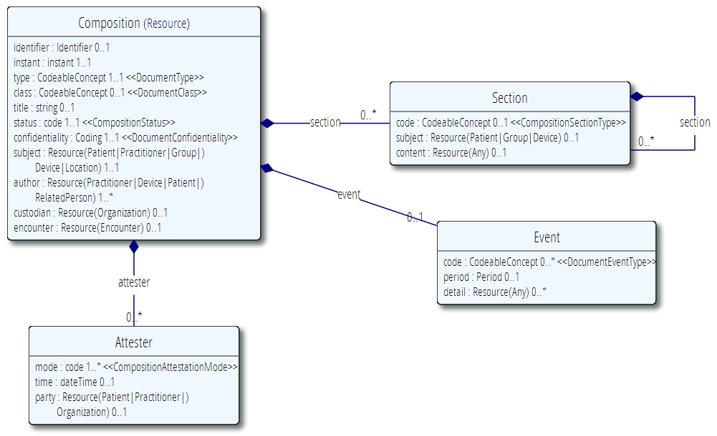
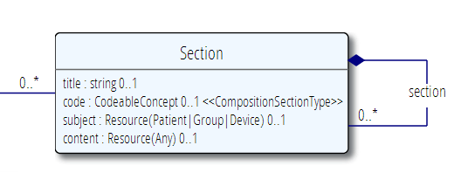
The Document resource
A single Resource, very often a List

Slide 103
FHIR Document
Discharge
Summary Composition
Dr. Bernard Practitioner
Patient Mary Patient
author
subject
Kidney Stones Condition
Chief Complaint section
content
Pulse Observation
Vital Signs list
entry
Physical section
BP Observation
content
Medications section
Discharge Meds list
Dyclofenac MedicationPrescription
content
entry
Tamsulosin MedicationPrescription

Slide 104
Documents – are bundles
<feed>
<entry>
<Composition />
</entry>
<entry>
<Observation />
</entry>
<entry>
<Device />
</entry>
<entry>
<Prescription />
</entry>
<entry>
<Patient />
</entry>
</feed>
Composition Resource
Section
Metadata
Attester
Section
Observation Resource
Device Resource
Prescription Resource
Patient Resource
Notes:
A Document, no matter how nested, is flattened to a list of entries, the Document’s header being the first.
The document header (and any other the other resources) refer to each other using normal references to reflect the document’s nesting.
Of course, there may be a digital signature (on the whole Bundle) to attest to the content of the document.

Slide 105
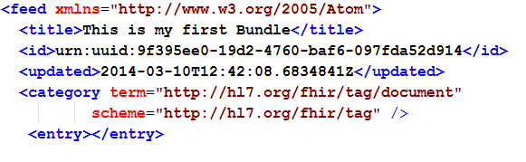
Tag as “Document”
This Bundle is a Document

Slide 106
Communicating documents
You can “drop” your document on
http://server.org/fhir/Mailbox
No storage or disassembly is implied, your just posting a document in its entirety.
Servers can implement any specific functionality as required between trading partners when receiving such a document.
Notes:
* But ofcourse, some server could have functions to disassemble documents on reception. Since the contents of documents are resources, each of the contained resources (including the Document header) can be stored using the normal REST interface. But they are no longer the document anymore!

Slide 107
Communicating documents
You can store your document using
http://server.org/fhir/Document
Storage, NO disassembly is implied, document (and signature) stays intact
Search is supported (you search on it’s Message header – Composition)
Notes:
* But ofcourse, some server could have functions to disassemble documents on reception. Since the contents of documents are resources, each of the contained resources (including the Document header) can be stored using the normal REST interface. But they are no longer the document anymore!

Slide 108
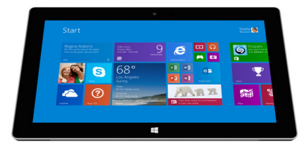
V3 and FHIR
CDA to FHIR Document bridge
FHIR Document processor
FHIR
Repository
FHIR
Documents
V3 CDA Documents
FHIR
REST
Hospital System A
Note: Documents are compositions,
No update semantics
Context?
Wholeness?

Slide 109
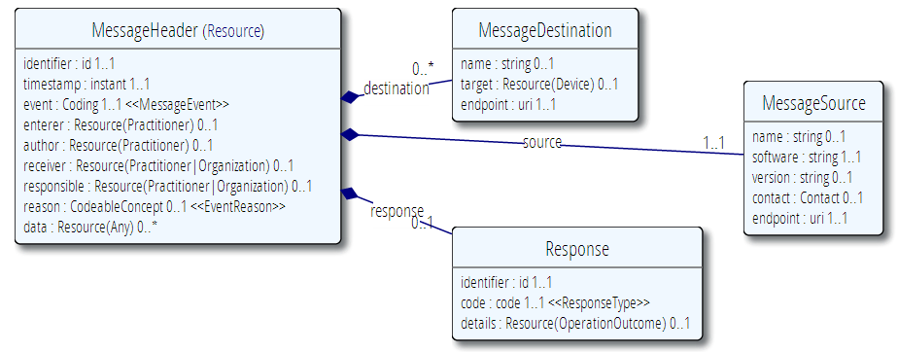
MessageHeader Resource

Slide 110
Messages – are bundles
<feed>
<entry>
<MessageHeader />
</entry>
<entry>
<Observation />
</entry>
<entry>
<Patient />
</entry>
<entry>
<Device />
</entry>
</feed>
Message Resource
source
destination
event
Observation Resource
Device Resource
Patient Resource
Notes:
A Message is similar, refers (amongst others) to its author, and contains information about the source, destination and the event that triggered it.
A message contains 1 “data” resource, which is the root of the payload of the message. This is just a normal resource, which in its turn can refer to other related resources.

Slide 111
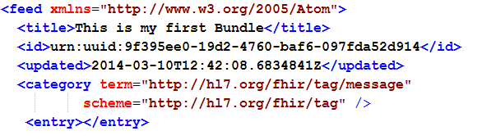
Tag as “Message”
This Bundle is a Message

Slide 112
Sending messages
Again, REST not necessary, but…
There is an explicit REST endpoint:
http://server.org/fhir/Mailbox
No storage implied. Might be a router, converted to v2, etc. etc.
The server can process them based on the event code and return the response as another message (again a bundle).
Notes:
* It’s the same drop-off point as for documents!

Slide 113
V2 and FHIR
V2 to FHIR bridge
FHIR Message processor
FHIR
Repository
FHIR
Messages
V2 Messages
FHIR
REST
Hospital System
Note: Messages are events,
REST exposes a “repository”
Model of data…

Slide 114
The Binary Endpoint
http://server.org/fhir/Binary/
Accepts any kind of content
Stores the content as is, along with the content type provided by the HTTP headers.
Acts just like the normal Resource endpoints (but there is no search)

Slide 115
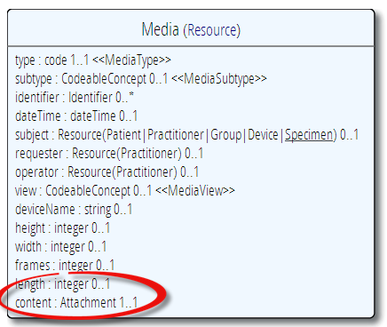
Useful for Attachments
/Binary/23344

Slide 116
INSIDE THE FHIR DISTRIBUTION
Notes:
Time: 2:25:00-2:35:00 (10 minutes)

Slide 117
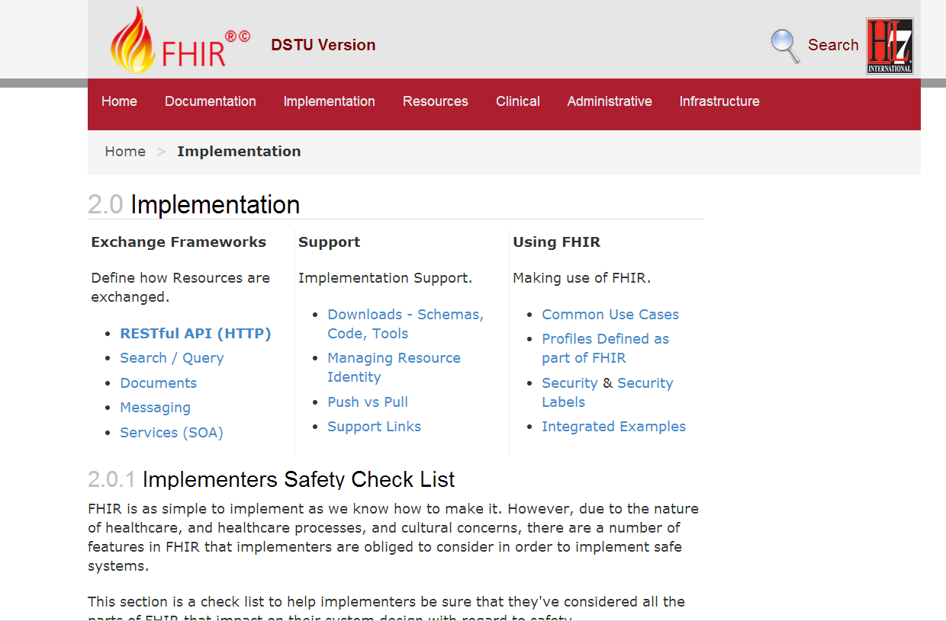

Slide 118
Browsing the site
REST API
Data Types
XML & JSON
Codes / Terminologies
Resource List
Stack Overflow
Public Test servers

Slide 119
The FHIR distribution
Under Implementation-Support-Downloads:
The XSD schema’s / schematrons
The Java / C# / Delphi zips (model, serializers, parsers, etc, both code & binary)
All xml + json examples
Full spec for offline reading (always have your FHIR with you)
Note! .NET implementation has moved to GitHub, distribution by NuGet (.NET) and Maven (Java)

Slide 120
In the FHIR SVN
All you need to build FHIR (/build)
All presentations (/presentations)
Source of the publication process (/build/tools, we use Eclipse + Java 1.6)
Archived older versions of FHIR (/archive)
You can download only the /build
Then run publish.bat & wait

Slide 121
The FHIR SVN
The “build” SVN tree, the “full” SVN tree
http://gforge.hl7.org/svn/fhir
User ‘anonymous’, blank password
Note: you have to run the publisher to be able to build the C# and Delphi source. Without that…they won’t compile!

Slide 122
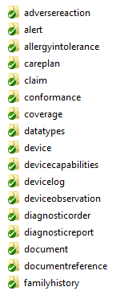
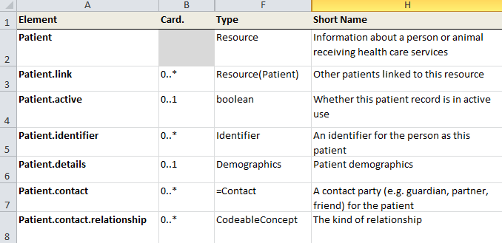
“Source” of FHIR
Straight from the HL7 SVN “code” repository
at gforge.hl7.org

Slide 123


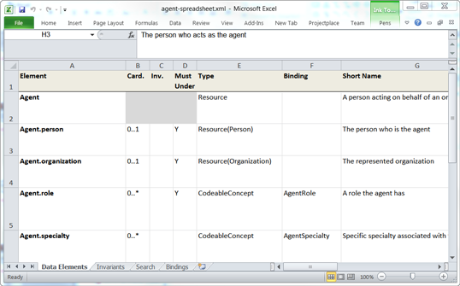

Publication process
.INI
examples
Publication tool
(org.hl7.fhir.tools.jar)
Website
Examples
Resource
UML
Java, C#,
Delphi
Validation
Schema’s
DictXml
Resource profiles
eCoreDefinitions.xml

Slide 124
Generator writers!
There’s a file called eCoreDefinitions.xml that the C# generator runs of. It has all details from the definitions
There are Profiles for each resource, basically describing the “unconstrained” resources

Slide 125
Profiles and validation
Short introduction to
Notes:
Time: 40:00-50:00 (10 minutes)

Slide 126
The need for Profiles
Many different contexts in healthcare, but a single set of Resources
Need to be able to describe restrictions based on use and context
Allow for these usage statements to:
Authored in a structured manner
Published in a repository
Used as the basis for validation, code, report and UI generation.

Slide 127

Constraining cardinality
Limit cardinality to 1..2
(e.g. to at maximum your organizations’ identifier + the national one)
1..2
1..1
0..0
Limit names to just 1 (instead of 0..*)
Forbid any telecom elements
Note: something that’s mandatory in the core definition cannot be made optional in a profile

Slide 128
Limit value domains
If deceased is given, it must be a dateTime, not a boolean
Use our national codes for MaritalStatus
OrganizationNL
=“true”
Use another profiled Resource
Fix value: Only allow “active” Patients

Slide 129
Tagging a Resource
Patient
MRN 22234
“Ewout Kramer”
30-11-1972
Amsterdam
http://hl7.org/fhir/tag/security
“I’m a VIP - My information cannot yet be disclosed”
http://hl7.org/fhir/tag “This is TEST data! Don’t use!”
http://hl7.org/fhir/tag/profile “I’m a Patient as defined in the Norwegian Profile – see http://hl7.no/Profiles/patient-no”

Slide 130

Validation

Slide 131
Validation
When receiving an XML resource
1. Validate using schema
2. Run schematrons
When receiving JSON
1. Parse the JSON
2. Serialize to XML
3. Validate using schema
4. Run schematrons
There’s a validation pack for Java

Slide 132

(Distributed) validation
App’s server
Profile X
Profile Y
Store &
Validate
Country validation server
Profile X
Validate Y
Profile Y
Download & Validate
Profile Y
Notes:
A server might defer validation to another server (because it doesn’t know the profile)
A server may fetch the “unknown” profile and validate it itself
There may be several servers sharing the work

Slide 133

Operation Outcome
When something goes wrong….return the OperationOutcome Resource!

Slide 134
Building a fhir server
FHIR in practice
Notes:
Time: 2:35:00-2:55:00 (20 minutes)

Slide 135
Some possible uses
v3
App
v2
FHIR
PHR
FHIR
Broker
Comm.
Interface
FHIR
DB
Notes:
You’re a message broker routing and translating between v2, v3 and FHIR
Your app interfaces with a PHR using FHIR natively
Your application can communicate using FHIR, but your software uses a proprietary RDBMS
Use FHIR as the common language for a Vendor Neutral Archive
…Or a combination….
You might see data as a nested structure of XML, a series of tables with keys, class-diagrams….

Slide 136
Repository model
HIS
LIMS
PACS
SystemX
Gateway
FHIR
FHIR
FHIR
FHIR
FHIR
Vendor Neutral Repository

Slide 137
Overview of a server
HTTP / REST interface
Encoding/decoding, param validation, syntax validation
Implement service operations as described in spec
Fhir Service
Indexer / Search
Storage

Slide 138
From wire to store
REST interface
JSON/XML
JSON/XML
JSON/XML
FHIR Parser
FHIR Parser
FHIR Parser
Fhir Service
POCO/POJO
POCO/POJO
POCO/POJO
O-R Map
Serialize
Serialize
Storage
NoSql (Xml/Json)
DBMS
DBMS
Notes:
First scenario is most common for existing databases: you have to map the FHIR structure (as POCO’s) onto your (existing) databases tables. Lot’s of mappings to support our nesting, cardinalities, datatypes
Second scenario uses the parsers to create POCO’s then use a NoSql driver’s serialization possibilities to store the structure-as-is in NoSql
Third scenario uses POCO’s and DBMS, but instead of mapping FHIR to tables, stores the data as-is into blob storage in a DBMS

Slide 139
Briefest intro to JSON
JSON (“JavaScript Object Notation”): it’s JavaScript, not markup!
{ “Country" : { “name" : “the Netherlands", “population" : 16696000,
“popDensity” : 447.9
}
}
var report = eval(“({…})”); alert(report.LabReport.status);
Very easy parsing for JavaScript clients. But actually, use JSON.parse() instead ;-)

Slide 140
Xml and JSON are different
Xml
JSON
<XXX xmlns=“urn:foo”>
<B a=“c” />
<C>One</C>
<C>Two</C>
<D>One</D>
<div>Not <b>so</b> easy</div>
</XXX>
{ “B”: { “a” : “c” },
“C”: [ “One”, “Two” ],
“D” : “One”,
“div” : {
“text-before”:“Not ”,
b:“so”,
“tekst-after”:“easy”}
}
How to retain namespaces?
How do you identify attributes?
Bridge difference in datatypes?
Distinguish single elements from lists with one element?
Mixed content?
Notes:
We tried to find a way to automatically convert between the two so you could round-trip…
But discovered you’d need additional metadata to do that, or vendor-specific solutions
Decided not to introduce these: result was weird Xml or weird Json
Reference platform contains tools to interconvert (these use model definition metadata)

Slide 141

Xml and Json in FHIR
code.coding is 0..*

Slide 142

Xml and Json in FHIR

Slide 143
Handling both
You need “meta” knowledge of the definition to distinguish lists / attributes
The Java/C# API’s can easily interconvert
Digital Signatures (in json?) are a problem when converting → store the original
JAXB / XmlSerializer / DataContract would need extensive customization / additional @annotation / [attributes]. Contact us!

Slide 144
Document-oriented store
A document-oriented store can store Resources as a “whole” document.
E.g. MongoDb stores documents in JSON:
post = { author: “mike”,
text: “my blog post...”,
tags: [“mongodb”,“intro”] };
db.posts.save( post );
db.posts.find( { author: “mike” } );
db.posts.find().sort({date: -1}).limit(10);

Slide 145


Slide 146


No (sql) transactions

Slide 147
Batch: needs transactions
Transaction
The transaction interaction submits a set of resources to be updated, created or deleted on the server. This interaction allows multiple resources to be updated/created in a single transaction. The interaction is performed by an HTTP POST command as shown:
POST [service-url] (?_format=mimeType)
The content of the post submission is a resource bundle.

Slide 148
Storing resources
FHIR POCO Model
Mongo
Patient
Atom Entry
(stored json)
Resource
Binary
Observation
Amazon S3
Metadata
Binary
Original
(json or xml)
Notes:
You might have to keep the original (as you received it on the service interface), for attestation/digital signatures
Store the binaries in another location (e.g. Amazon S3, filesystem) and just keep the URL here.

Slide 149
RDBMS: BLOB + Index
Id | ResourceId | VersionId | LastUpdate | Contents
1 | 1 | 1 | 2012-12-19 | <Patient …>
2 | 1 | 2 | 2012-12-20 | <Patient …>
3 | 2 | 1 | 2012-12-20 | <Observation …>
Id | Param | Value | System
2 | Patient.Name | “Ewout”
2 | Patient.DoB | “1972-11-30”
3 | Obs.Code | “234332” | SNOMED
Separate tables for current and history?
Type | VersionIdHigh
Patient | 2
Lab | 3
Need to index only latest version!

Slide 150
Both implementations use a separately maintained index for search?
Yes, here’s why…

Slide 151

Predictable search
Each resource has a fixed set of search parameters:
Searched element
Parameter
Type

Slide 152
Types of parameters
integer | Search parameter must be a simple whole number.
string | Search parameter is a simple string, like a name part. Search is case-insensitive and accent-insensitive. May match just the start of a string.
date | Search for an exact match on a date (parameters look like 1956-05-27T12:34:12+04:00 or shorter)
token | Search parameter on a coded element or identifier. May be used to search through the text, displayname, code and code/codesystem (for codes) and label, system and key (for identifier).
reference | A pair of resource type and resource id, separated by "/". Matches when the resource reference resolves to a resource of the given type and id.
Note: you need to escape the query-string!!

Slide 153
Partial/combined match
The search parameter description shows that the match certainly isn’t always exact, and can even combine the contents of several elements:
Name / Type | Description
address : string | an address in any kind of address/part of the patient
family : string | a portion of the family name of the patient
given : string | a portion of the given name of the patient
name : string | a portion of either family or given name of the patient
phonetic : string | a portion of either family or given name using some kind of phonetic matching algorithm
telecom : string | the value in any kind of telecom details of the patient

Slide 154

Prepare your data!
patient/search? name=johan& name=grafin& telecom=5552004
“Groom” – prepare for searching

Slide 155
The end is near…
Notes:
Time: 10:00-35:00 (25 minutes)

Slide 156
Balloting plans
First Draft Standard for Trial Use ballot (DSTU) complete
FHIR is now published as a DSTU
Will provide a semi-stable platform for implementers while still allowing non-backward-compatible change for Normative version if implementation experience dictates
Additional DSTU versions roughly annually to make fixes, introduce new resources
Normative is around 3 years out
We want *lots* of implementation experience before committing to backward compatibility

Slide 157

Next Steps for you
Read the spec: http://hl7.org/fhir
Try implementing it
Come to a (European?) Connectathon!
fhir@lists.hl7.org
#FHIR
Implementor’s Skype Channel
FHIR Developer Days (November 24 – 26), Amsterdam
StackOverflow: hl7 fhir tag

Slide 158






International HL7 FHIR Developer Days November 24-26, 2014 in Amsterdam
Education
14 tutorials
pick & choose
Connectathon
Meet fellow developers
Put FHIR to the test
Networking
FHIR experts and authors on hand
http://fhir.furore.com/devdays

Slide 159
QUESTIONS?
Notes:
Time: 10:00-35:00 (25 minutes)

